Slide 1
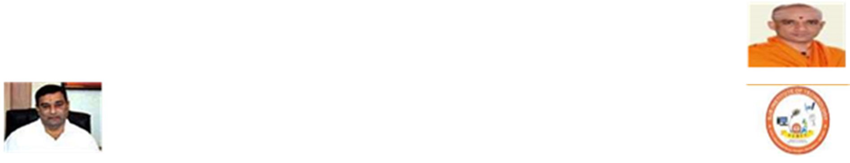


SJB Institute of Technology
Project Review III
on
“PERSONALIZED CREDIT SCORE”
Under The Guidance of
Dr. Srikantaiah K C
Professor
Department of CSE
Presented By
Shreyanshi [1JB13CS148]
Shriyanka B V [1JB13CS149]
Shubham Verma [1JB13CS152]
Sujeet Kumar [1JB13CS160]

Slide 2
Introduction
A number ranging from 300-850
It represent a person’s credit-worthiness
Higher the number, more the credit-worthiness
Used to evaluate potential risk in lending money to lenders
Calculated and maintained by CIBIL in India
Adopted by banks and credit card companies

Slide 3
Literature Survey
S. No. | Paper Name | Year | Description | Publisher
1 | Credit Rating in India: A Study of Rating Methodology of Rating Agencies | 2011 | To assess the consistency in rating methodology of each individual rating agency by taking companies | Global Journal Of Management And Business Research
2 | The impact of credit scoring on consumer lending | 2013 | Adoption of automated credit scoring and the changes it enabled in lending at a large finance companies. | GRAND Journal Of Economics.

Slide 4
3 | Research and application of credit score based on decision tree algorithm | 2011 | Introduction to the basic process of decision tree algorithm | College of Finance, The University of Zhejiang Gongshang
4 | A study of awareness about CIBIL and credit information reports among customers at commercial banks | 2014 | To study the awareness level of CIBIL among customers at commercial banks. | International Journal of Research Aspects of Engineering and Management

Slide 5
Problem Statement
Alternative payment date of contractual agreements are not taken into consideration
No ready access nor it is freely available
Low awareness on improving individual’s credit score
Financial Institutions cannot proactively identify consumers who are likely on their loans
Social influence of individual plays no role in the calculation of their credit score
Online contractual payments do not contribute in building credit score.

Slide 6
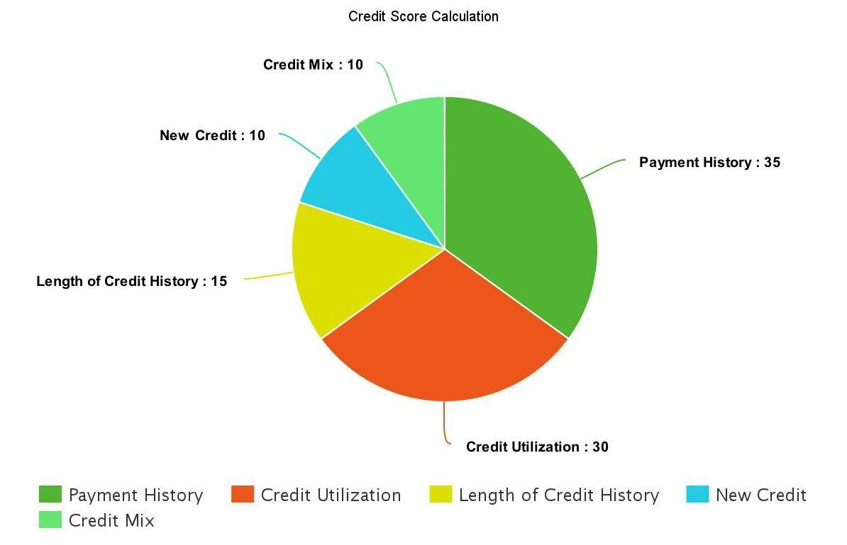
Existing System

Slide 7
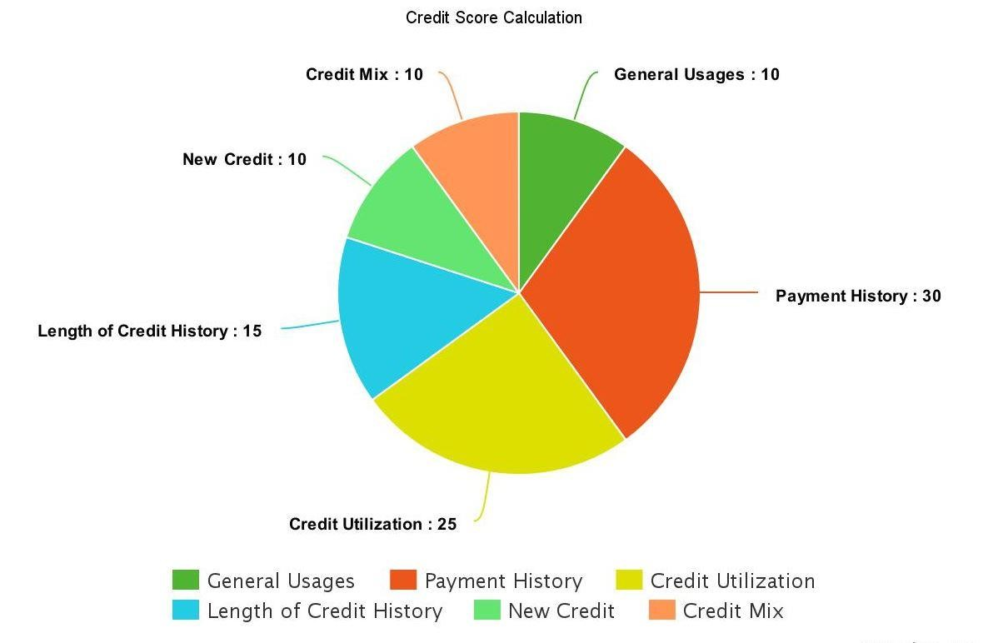
Proposed System

Slide 8
Requirement Analysis
Software Requirement | Hardware Requirement
Android Studio Android SDK Android Emulator XAMP/Online Free Web Hosting & MySQL Database Front End - XML and Javascript Back End – PHP and MySQL | 6GB RAM Android Phone 20GB Hard Disk

Slide 9
Functional Requirement
Functional requirement are those that refers to the functionality of the system, i.e. what services admin provides to the users.
Admin Session
Admin can register user who signs up with the application.
Admin can fetch the detail of the customer based on the detail provided by the user.
User Session
User gets a platform to view his credit score.
User can view the benefits based on his credit score.

Slide 10
Non-functional Requirement
Non-functional requirements are the other information needed to produce the correct system. These are constraints within which the system must work. These are listed below:
Usability: Both user and admin can be able to use the system with ease and comfort.
Reliability: The output of the system should be reliable to the user, i.e. system should deliver correct output and helpful information.
Performance: Performance of the system should be good and fast.
Maintainability: The System should be optimized for supportability, or ease of maintenance as far as possible.

Slide 11
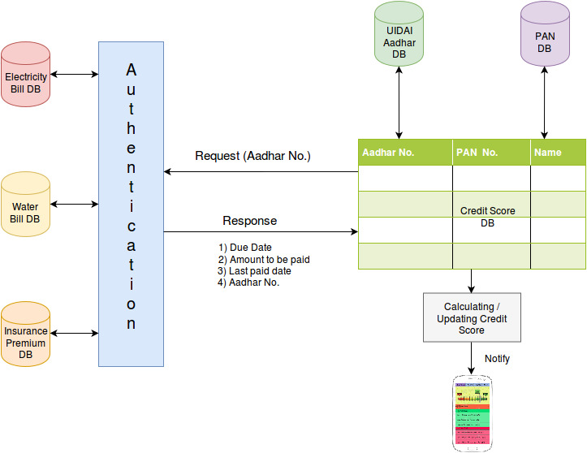
System Design

Slide 12
SYSTEM ARCHITECTURE

Slide 13


USE CASE DIAGRAM
Application Server
Login/Logout
Checking Live Scores
UID Authentication Server
Benefits
USER
AADHAR Verification
PAN Verification
PAN Authentication Server

Slide 14
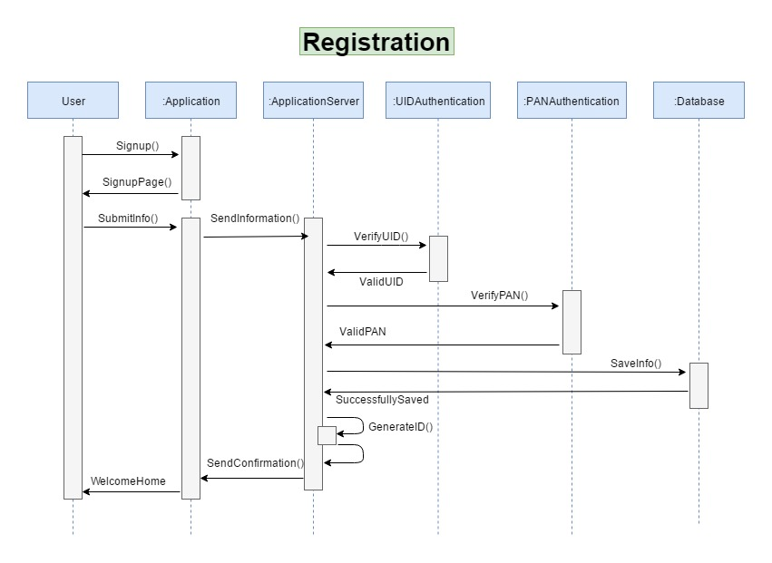
SEQUENCE DIAGRAM

Slide 15
IMPLEMENTATION
UID VERFICATION MODULE (UVM)
Sends the user UID to UID Authentication server to check if it’s valid
FACE DETECTION MODULE (FDM)
detects user’s face and unlocks the application
APPLICATION SERVER MODULE (ASM)
Calculates live score of the user
Links to UVM for aadhar verification
Links to PVM for PAN verification
Stores user details to Database
Links to OVM for OTP generation
Links to FDM for identifying the user.
USER MODULE
Registers himself/herself to AS module
Logs into account using AS module
Checks live score
OTP VERFICATION MODULE (OVM)
Sends OTP to user’s mobile for security
PAN VERFICATION MODULE (PVM)
Sends the user PAN to PAN Authentication server to check if it’s valid
OTHERS
Settings
Prediction

Slide 16
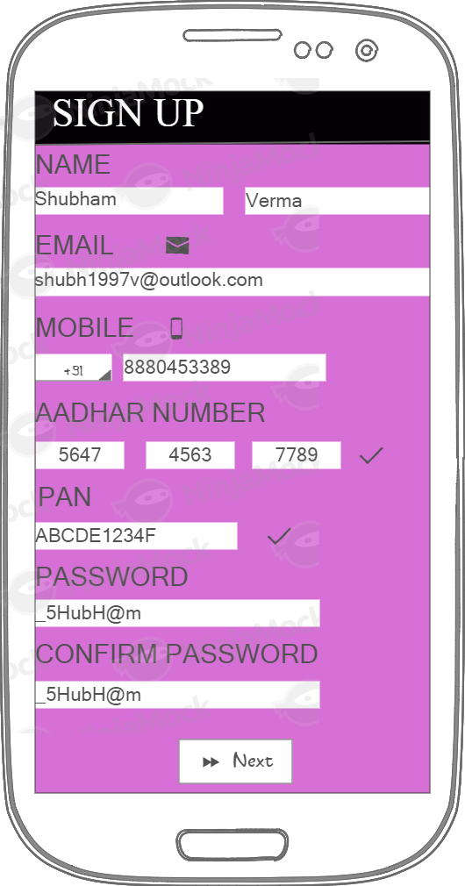
WORK DONE SO FAR(contd..)
SIGNUP PAGE
GET Username
GET Email
GET Mobile_no
GET UID_no
GET PAN_no
IF (PAN==True && UID==True)
THEN
Login Successful
ELSE
User already exist.
ENDIF

Slide 17
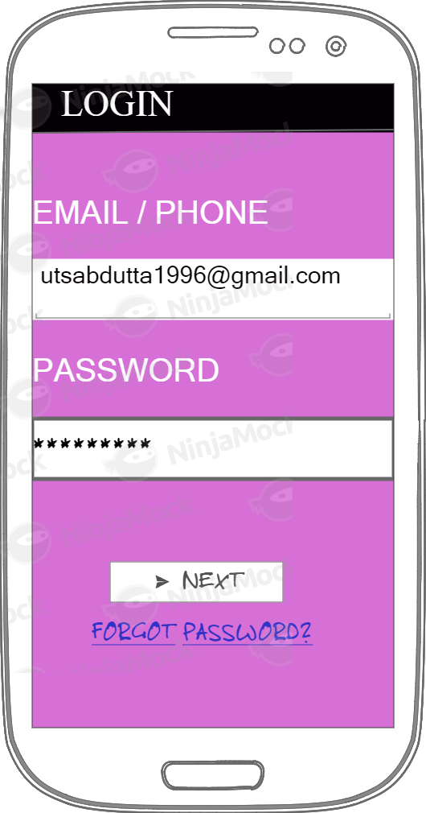
WORK DONE SO FAR
LOGIN PAGE
GET Username
GET Password
IF (Username == EnteredUsername && Password == EnteredPassword) THEN
Login Successful
ELSE
Login Failed.
ENDIF
abc@gmail.com

Slide 18
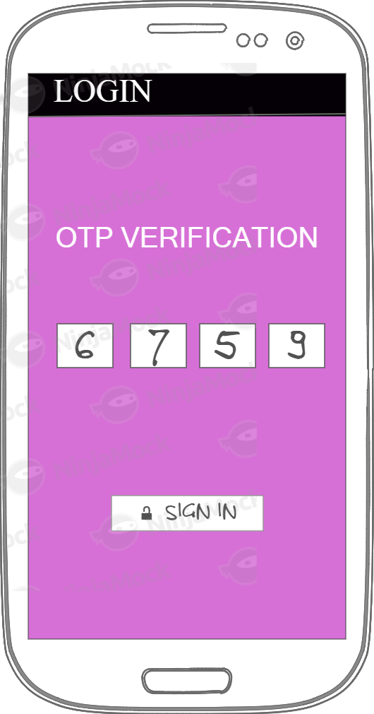
WORK DONE SO FAR(contd..)
OTP Page
1.Generator code
Required parameters:
recipient (string) - phone number in international format.
sender (string) - name of the sender (min 3, max 11)
Optional:
length - length of the code (min 4, max 10, int) (default = 5)
expiry - expiry in seconds (min 10, max 3600, int) (default = 60s)
allow Push (boolean) - Allow code to be send via push notification.
2.Verify code
Required parameters:
id - code identifier (string)
code - the code (string)

Slide 19
PLAN OF ACTION
LITERATURE SURVEY
(26-FEB-2017)
SYNOPSIS
(2-FEB-2017)
REQUIREMENT ANALYSIS
(4-MAR-2017)
DESIGN
(20-MAR-2017)
IMPLEMENTATION
(25-APR-2017)
TESTING
(12-MAY-2017)

Slide 20
CONCLUSION
PERSONALISED CREDIT SCORE Application provides –
Live scores
Security features
Verifies AADHAR card number
Verifies PAN of the user during signup
Sends OTP during every login of the user

Slide 21
REFERENCES
[1] J. Simon and P.J. Simon, Head First Android development. Sudbury, MA, UnitedStates: O’Reilly Media, Inc , USA, 2011.
[2] Jackson, W. (2013). Learn Android app development. Berkeley, CA: SPRINGER A PR TRADE.
[3] Sierra, K., Bates, B. (2005). Head first java: [your brain on java – a learner’s guide] (2nd ed.). Boston, MA, United States: O’Reilly Media, Inc, USA.
[4] K. Jamsa, Introduction to web development using Html 5. Sudbury, MA, UnitedStates: Jones and Bartlett Publishers, 2013.
[5] R. Chopra, Database management system (DBMS): A practical approach: Concepts, principals, case studies, experiments. New Delhi: S Chand & Co, 2010

Slide 22


